Slide 1
Exercise tracking app
Siamese Cat Group
Team Members
Mike Smith
Dan Casazza
Logan Geoffrion
Logan Keyes
Shankarri Ragavan
Jared Siriba

Slide 2
What you can do with the app
You can Sign up and have an user account to maintain your Workout information in one place
You will be able to track your exercises you do throughout the day
Log your workout activity
View goal progress in the workout log
You can set daily, weekly or monthly goals
This app is shared, therefore you can see your friends’ List in the Members board to know who has been Working outing along with you in your city and state

Slide 3
motivation
Need to track exercise activity
Share with friends for motivation
Maintaining all the information of your Workouts in a single place

Slide 4
Technologies and tools
NPM used
Express,
Express-sessions,
Materialize-css,
Jquery,
Mysql,
Mysql2,
Passport,
Passport-local,
Sequelize
Javascript,
Jquery,
Node,
Mysql,
Materialize,
css,
Html

Slide 5
Database Schema
Users
Id
Email
Name
Password
Workout Types
Id
Workout Name
Calories per Hour
Work out Log
Id
User Id
Challenge Id
Workout Id
Workout Duration
Create Date
Workout Challenge
Id
Name
Goal
Challenge Duration
Create Date

Slide 6

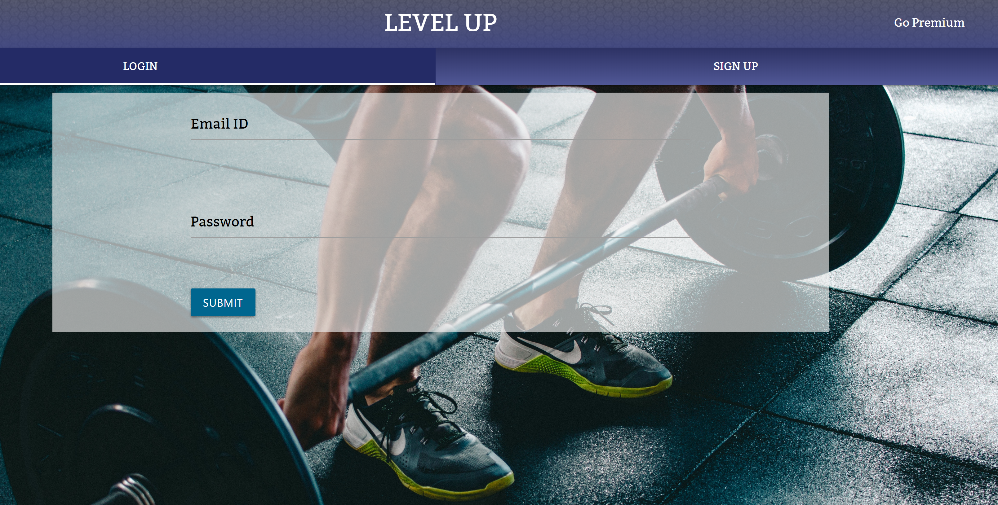

Slide 7
demo
https://levelupworkout.herokuapp.com/

Slide 8
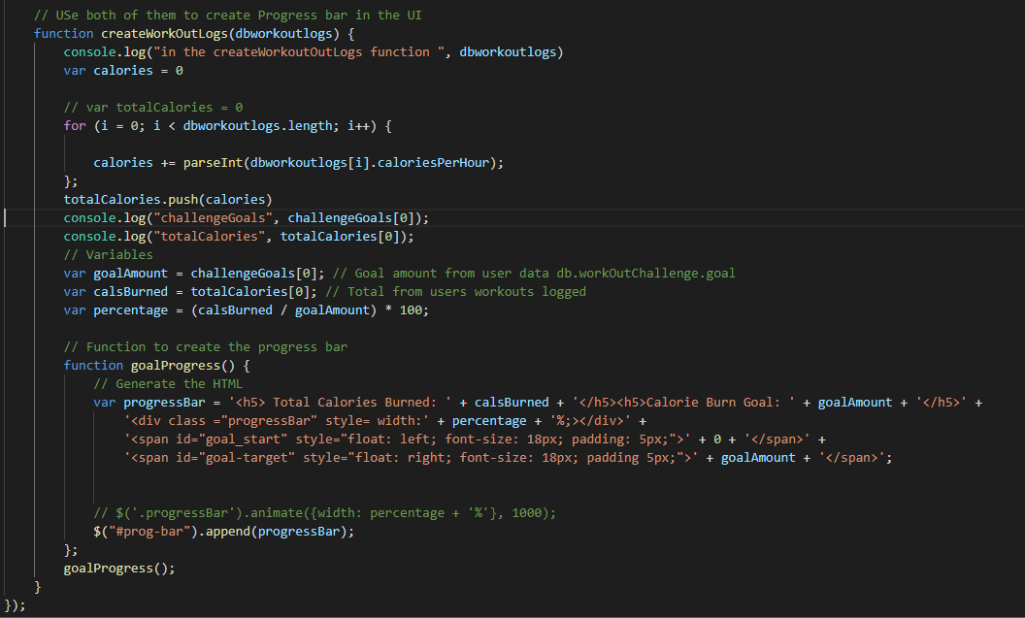
Code snippet

Slide 9
Direction for future development
Add in wide Variety of Workouts for tracking.
Send in messages or emails to nudge user to work out more to reach the set Goal
Get Leader Board information so we can compare progress among members to provide motivation to workout.
Link the app with activity trackers like FitBit so we can get the Workout information directly from them instead of user manually entering the workouts

